Slide 1
Fishing For Starters
Where to begin?

Slide 2
What Rod?
Fly Rod – more challenging, yet rewarding.
      Casting the line
Spin Cast – more common first experience
      - Casting the line
Retrieve or Bobber Fish? (preference)
  Once another angler is successful, all others want to do that type of fishing

Slide 3
Deciding which Hand to use on the reel
You can use most reels two ways: for left hand retrieve (the most common) and for right hand retrieve
We use the best hand to cast, and don't want to switch hands once a fish is hooked. But some anglers actually cast an wind with the same hand, and switch the rod over once a fish is hooked.

Slide 4
Leader & Tippet
Let's cover the basics first: the leader and the tippet are the two terminal parts of the setup before your fly. The leader is attached to the front end of the fly line and the tippet is attached to that. Your fly is tied to the tippet.
The purpose of the leader is twofold:
1) To lead from the thick and clumsy fly line to a thin and delicate tip that can actually pass through the eye of the fly
2) To transfer power from the fly line to the fly in such a way that the last bit of movement is gone when the fly is delivered

Slide 5
How to choose the right Leader Length
Leader Length | Best suited for…
6 foot | Sinking fly lines of all types, panfish, bass, trout in tiny, brushy streams
7.5 foot | Trout in streams from 10-20 feet wide, intermediate and sinking tip lines in lakes and saltwater conditions where the fish are not terribly spooky. Also streamer fishing for trout with big weighted flies.
9 foot | Trout streams larger than 20 feet wide where the water is mostly riffled, or else the fish are not spooky. In salt water, fish in shallow water under bright, clear conditions.
12 foot | Trout in lakes with floating lines. Trout in streams when the water is flat, low, or very clear
15 foot | Spooky trout in extremely clear water in both lakes and rivers.

Slide 6
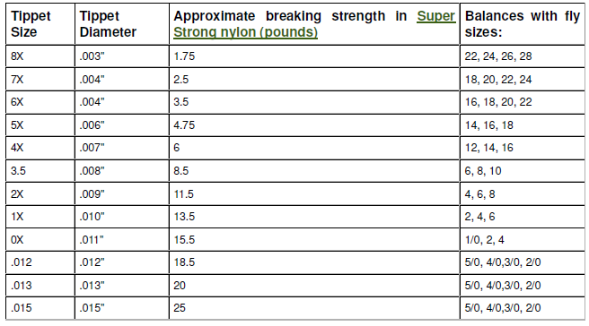
How to choose the right tippet size

Slide 7
Knots
Blood knot
Surgeon’s knot
Clinch knot
Improved Clinch knot
Perfection Loop
Grog’s Knots

Slide 8
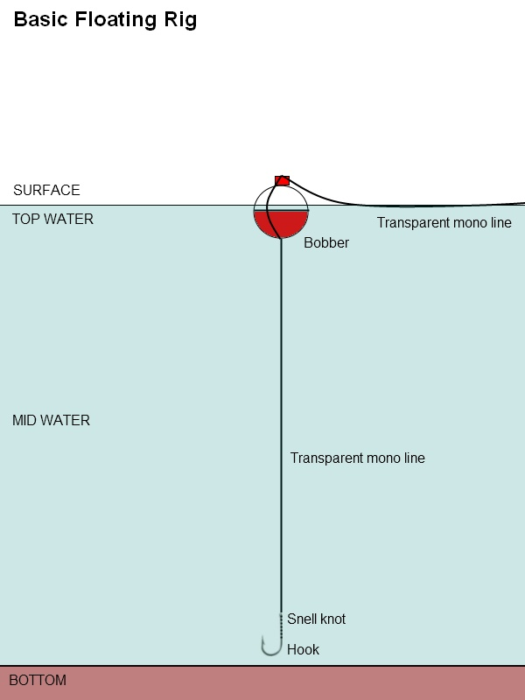
Bobber or Indicator set up

Slide 9
How to be more successful
Research the layout of the water – example Lafarge Lake
Know the Provincial Regulations for the water
Look for insects
Small coastal trout lakes, in general, do not support high enough concentrations of the key nutrients to grow fish as big as those found in their interior counterparts. This is due in part to prevailing geological conditions and increased amounts of total precipitation which result in high flushing rates. Invertebrate life in coastal lakes is generally less diverse and abundant than those found in the interior regions.

Slide 10
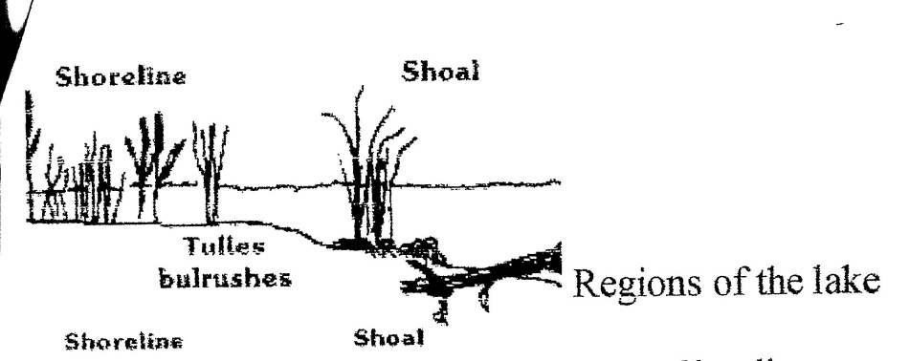
Lake Profile
Drop Off

Slide 11
Resources
http://catchthethunderflyfishingandconservationclub.yolasite.com/
https://www.facebook.com/people/Thunder-Angling/100009642186183

